Slide 1
Projects based on the
Web Processing Service framework birdhouse
Carsten Ehbrecht¹, Tom Landry², Nils Hempelmann²,
David Huard³, Stephan Kindermann¹
German Climate Computing Center (DKRZ), Germany
Computer Research Institute of Montreal (CRIM), Canada
Ouranos, Canada
<number>

Slide 2
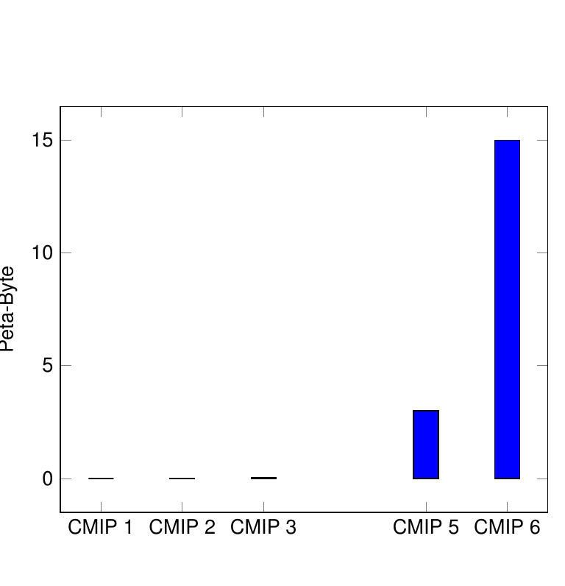
Growing Amount of Data (Example Climate Model data)
CMIP 1 | 1 GB | IPCC AR 1 1990
CMIP 2 | 500 GB | IPCC AR 2 1995
CMIP 3 | 35 TB | IPCC AR 3 2001
 | Not existing | IPCC AR 4 2007
CMIP 5 | 3,5 PB | IPCC AR 5 2014
CMIP 6 | 10-20 PB (in ESGF) | IPCC AR 6 12-16 April 2021
CMIP = Coupled Model Inter-comparison Project
IPCC = Intergovernmental Panel of Climate Change
ESGF = Earth System Grid Federation
<number>

Slide 3

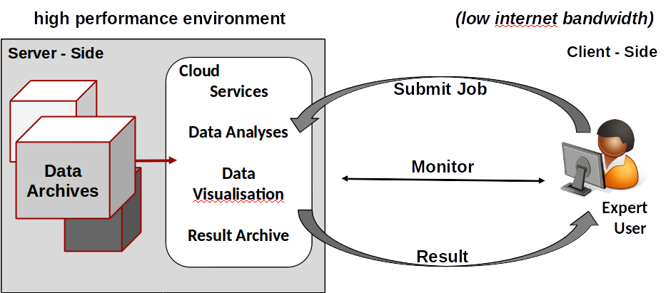
Web Processing Service
<number>

Slide 4
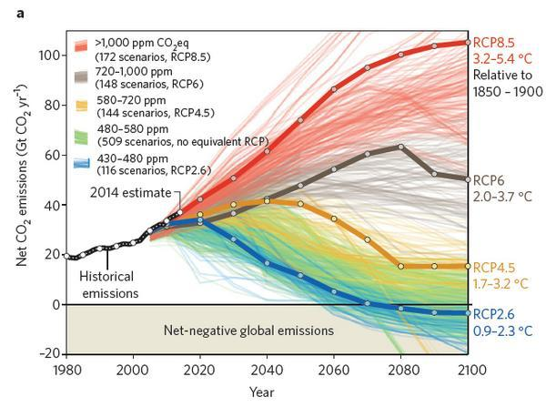
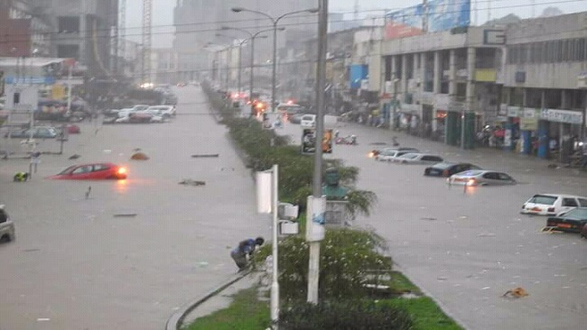

Advantage of Server-Side Services
Avoiding of double work
Decrease difficulties for accessing raw / processed data
Improved quality (continuous testing by the user community)
Increased visibility of Developers/Researchers
Sharing:
methods
compute resources
storage space
result data
Standardized way of producing results (Monitoring)
Enable multidisciplinary projects with synergies between groups
low cost
<number>
Notes:
Maybe a picture for motivation and just a few text keywords?

Slide 5

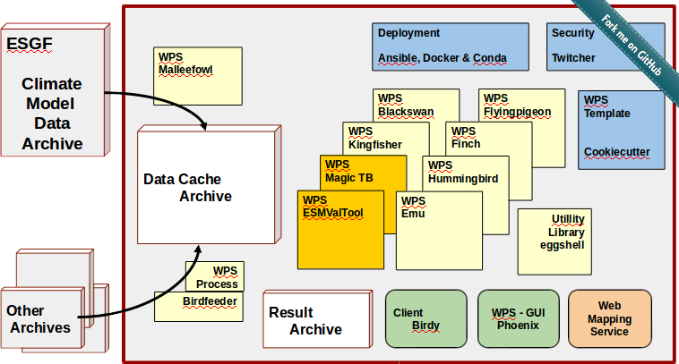
Birdhouse Ecosystem
EMU
Test suite
Flyingpigeon
Sandbox
Malleefowl
ESGF search&fetch
Blackswan
Extreme Event assessment
Kingfisher
EO-Data
Hummingbird
Data Quality Control
Finch
Climate Impact
ESMValTool
EarthSystem
Validation
Magic Toolbox
Climate indices
<number>
Notes:
We are using PyWPS … though not restricted to it (Zoo, 52North, ....)

Slide 6








Server Side: Deployment
Web Processing Services
Software
Repository
Deployment
Solution
Setup WPS Project
CP4CDS
OGC
Testbeds
CP4CDS
Pavics
OGC
Testbeds
A2C2
CP4CDS
Pavics
Other non public nodes
<number>
Notes:
You can use the “Birdhouse WPS Setup” to create your own WPS project (Finch, Kingfisher, …) and using the same deployment solution (Conda, Ansible, Docker).

Slide 7
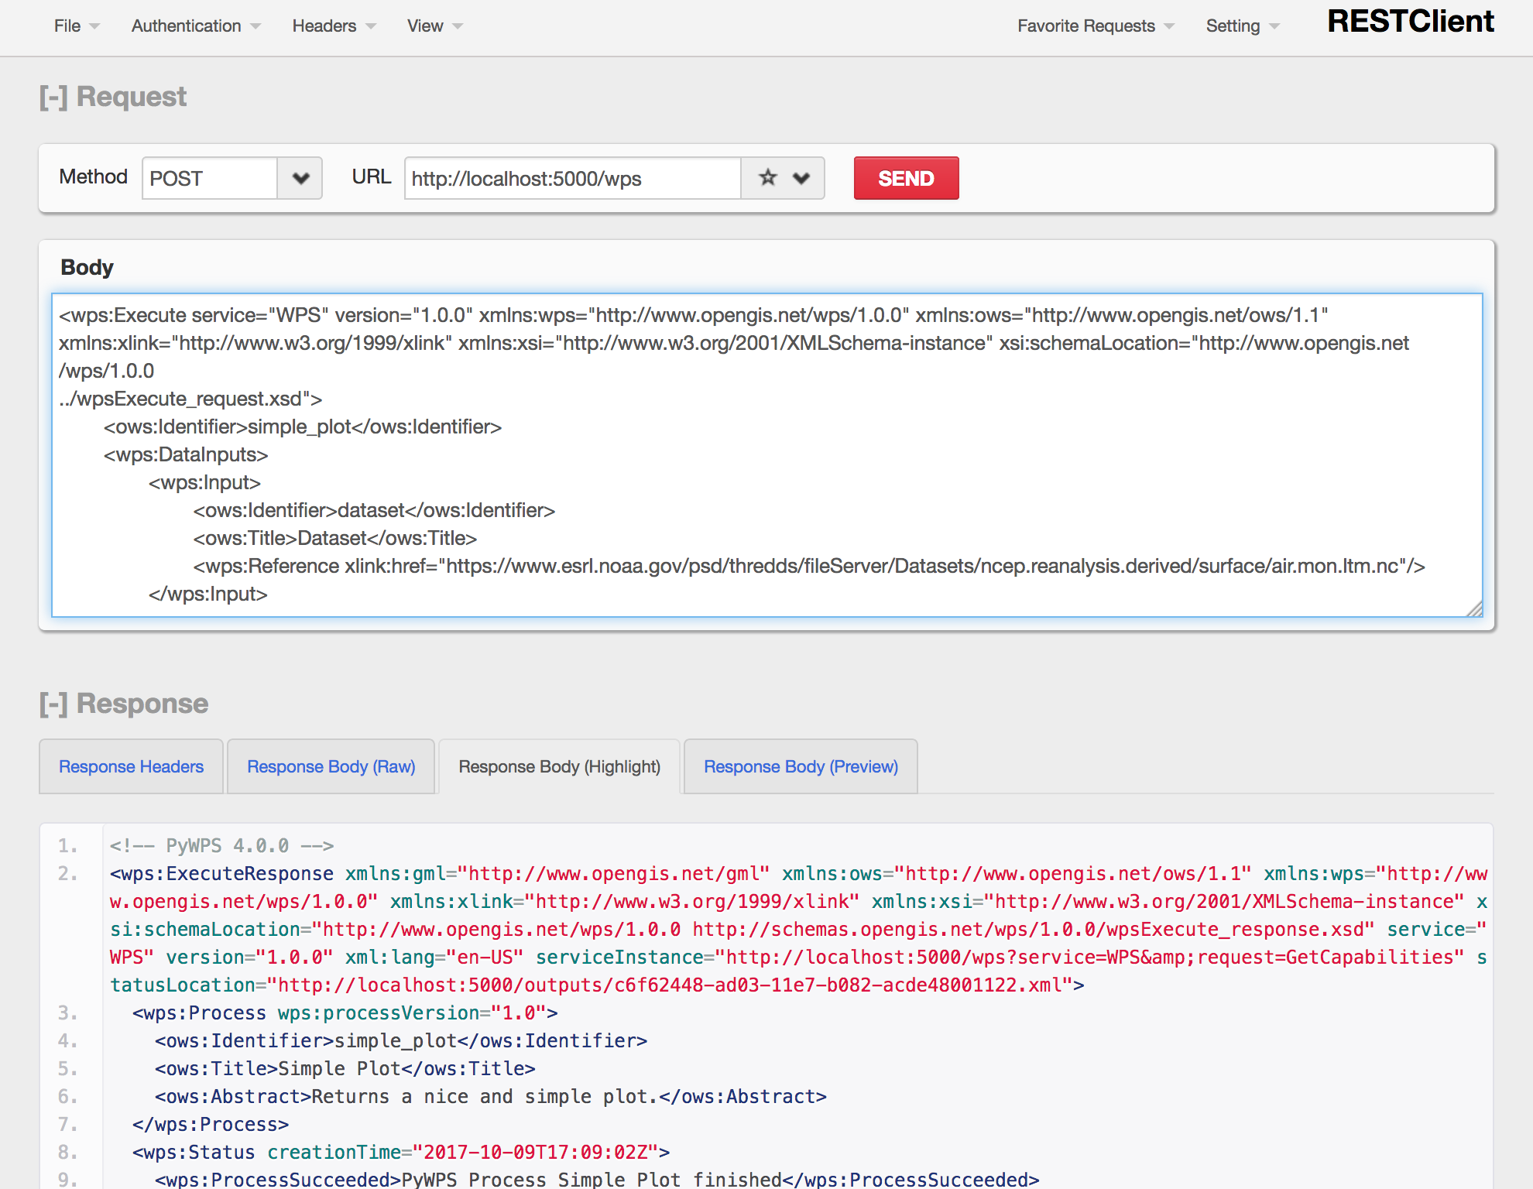
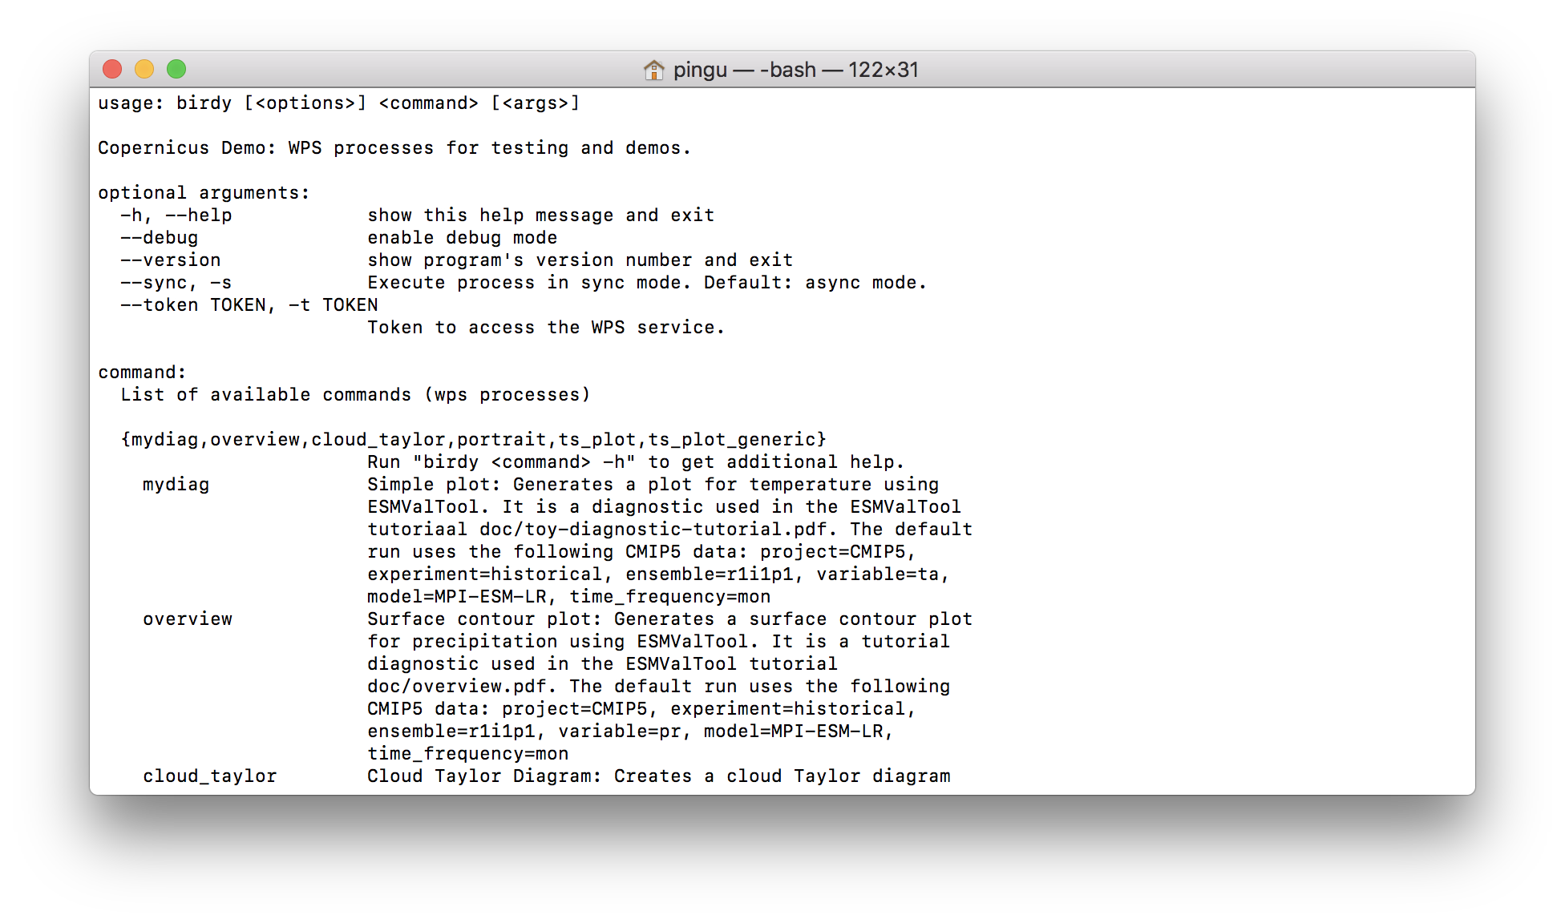
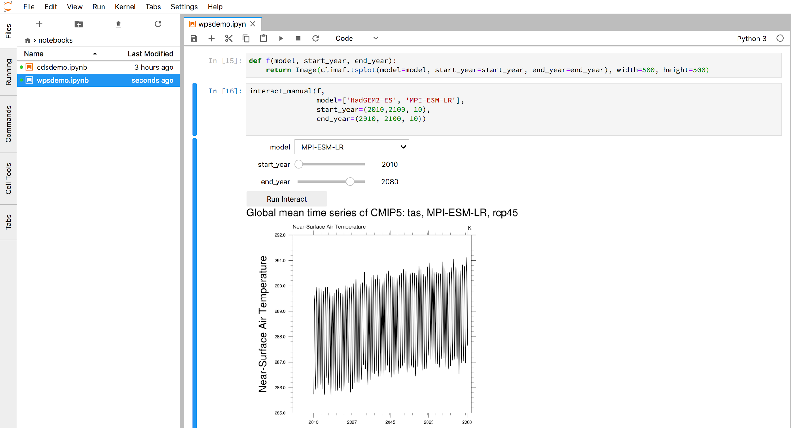
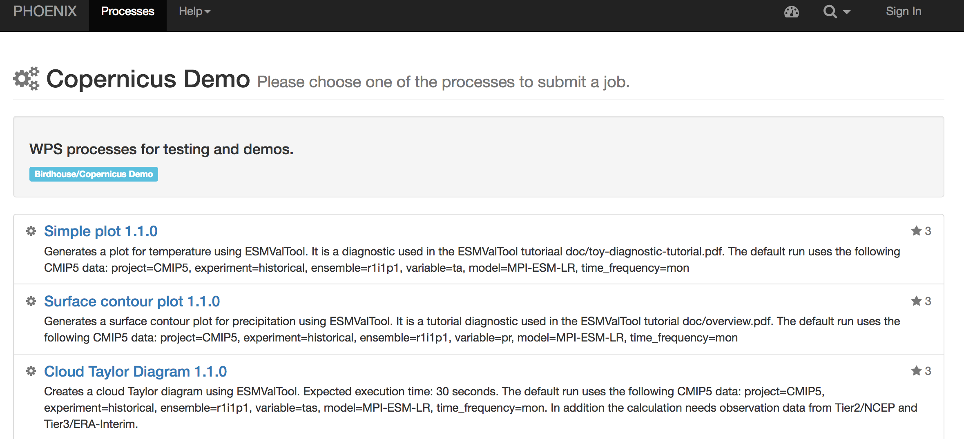
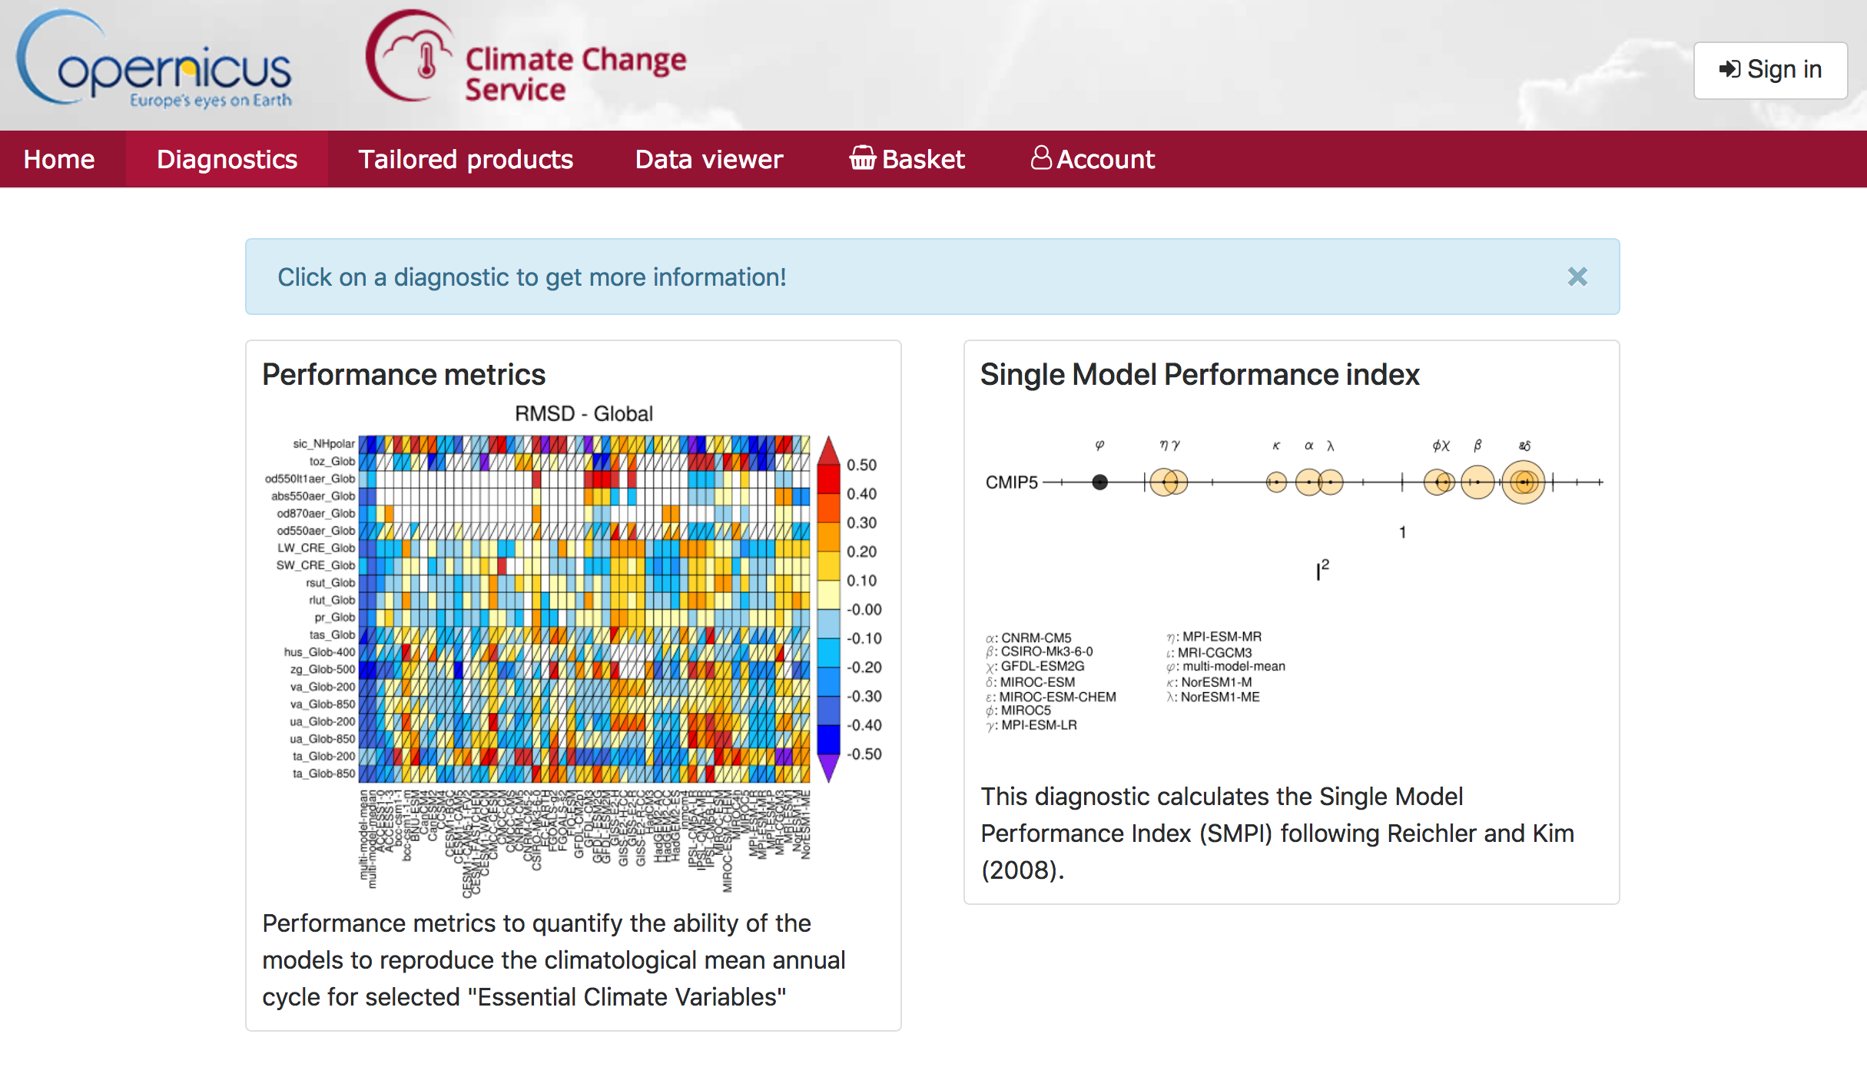
Client Side: Many Views on WPS
<number>
Notes:
The same WPS service can be accessed by various kinds of clients just relying on the WPS protocol.
Call WPS directly via HTTP request (use curl, Firefox RESTClient, …)
Use Birdy (with OWSLib): command-line, Jupyter Notebooks
Use web application like Phoenix as a generic WPS client
Project specific web portals: Copernicus CDS, PAVICS

Slide 8
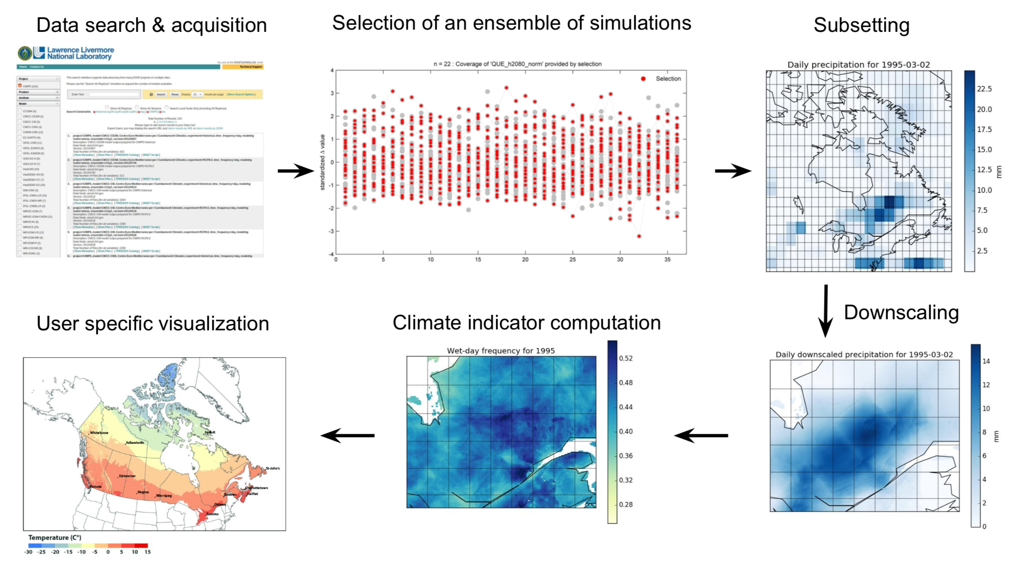
Example of Processes & Workflows
<number>

Slide 9




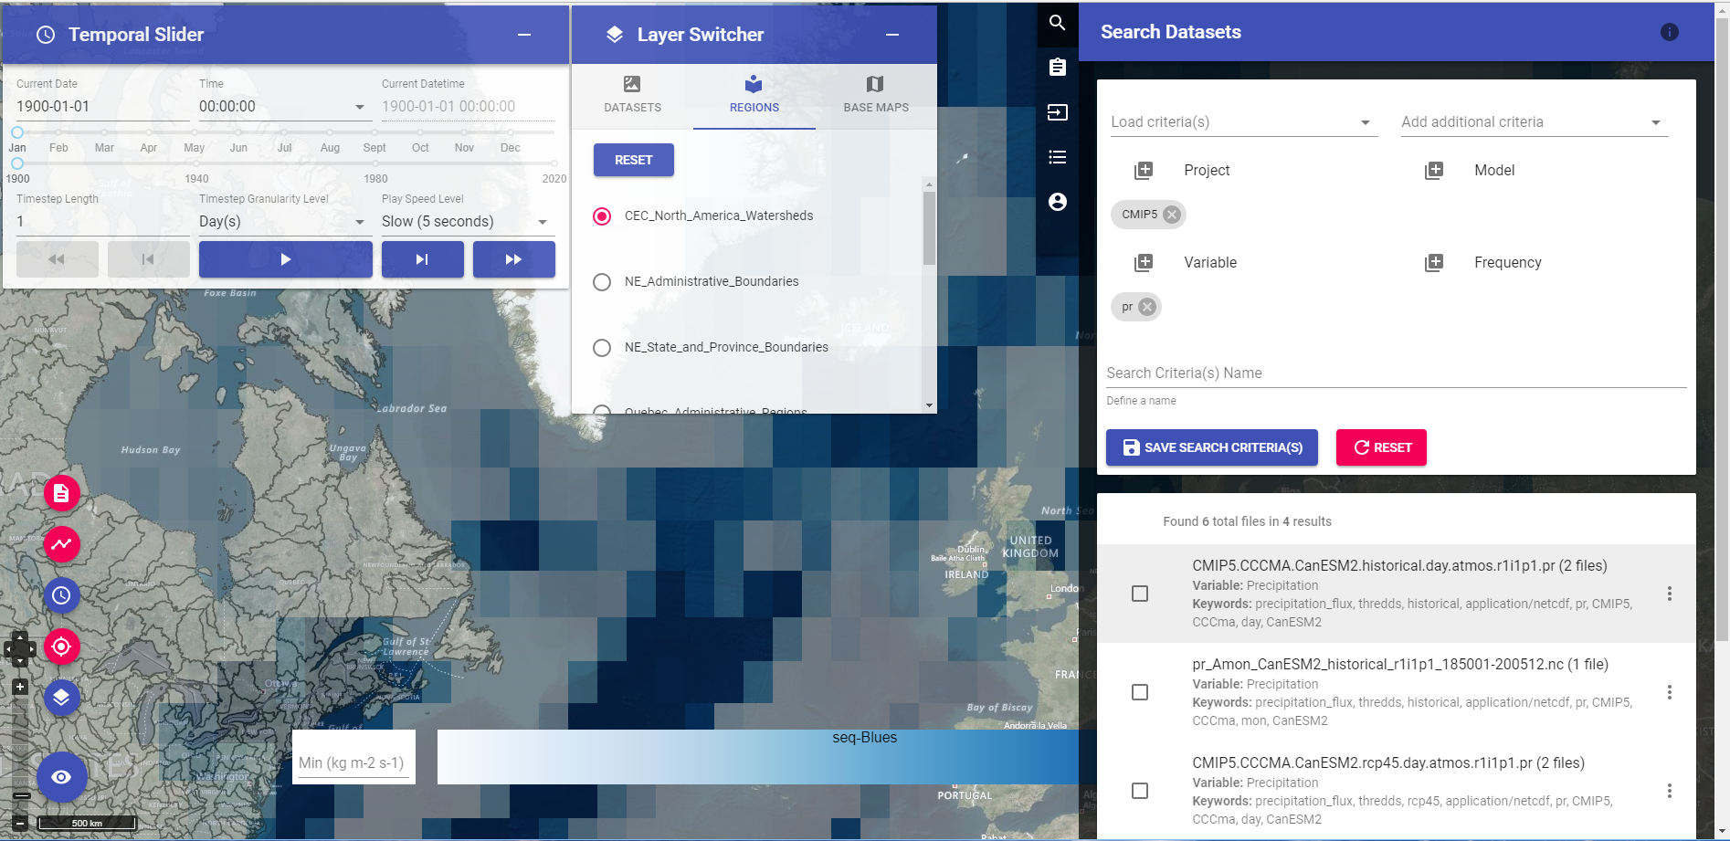
Project: PAVICS
<number>

Slide 10
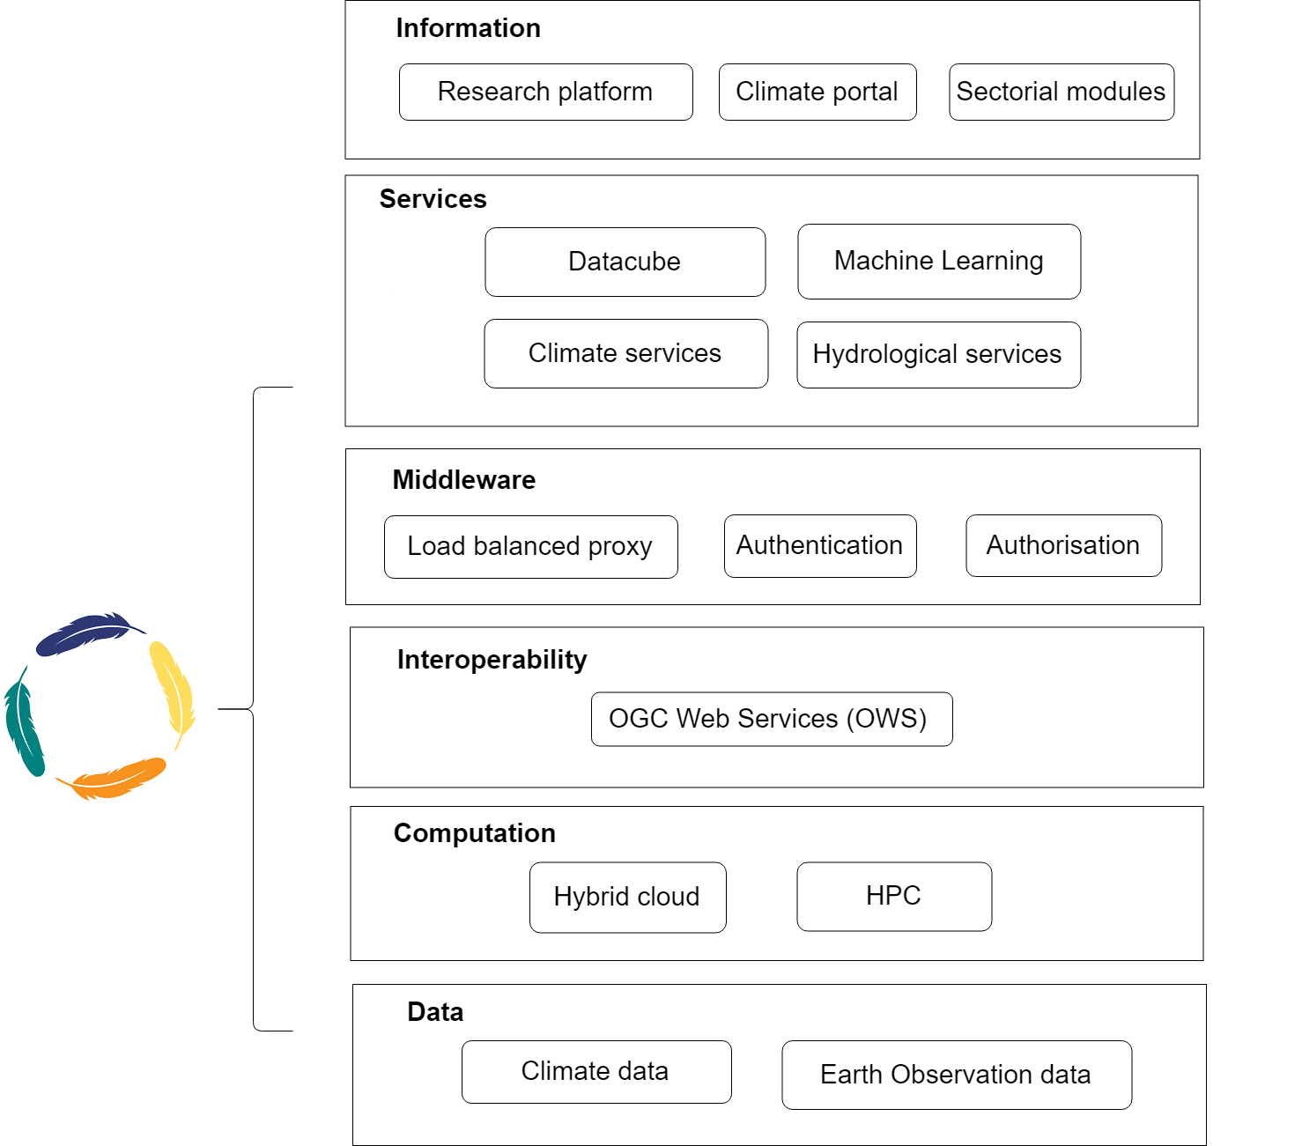
Project: PAVICS NexGen
Canadian-led Science Gateway
Will provide a federated cyberinfrastructure
Advanced hydro & climate services, Machine Learning and Earth Observation tools
Geospatial Interoperability through OGC Web Services
<number>

Slide 11
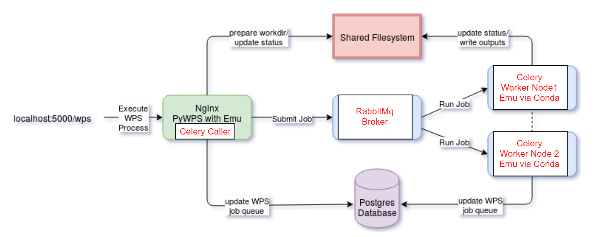


Project: OGC Testbeds
OGC Testbeds:
Collaborative efforts to define, design, develop, and test candidate interface specifications.
Testbed-13:
Builds on Birdhouse and PyWPS HPC scheduler
Implements cloud computing & application packaging (Docker)
Testbed-14:
Extends Birdhouse security and job processing (OpenAPI)
Implements interoperable workflows (CWL, OWS Context)
<number>

Slide 12
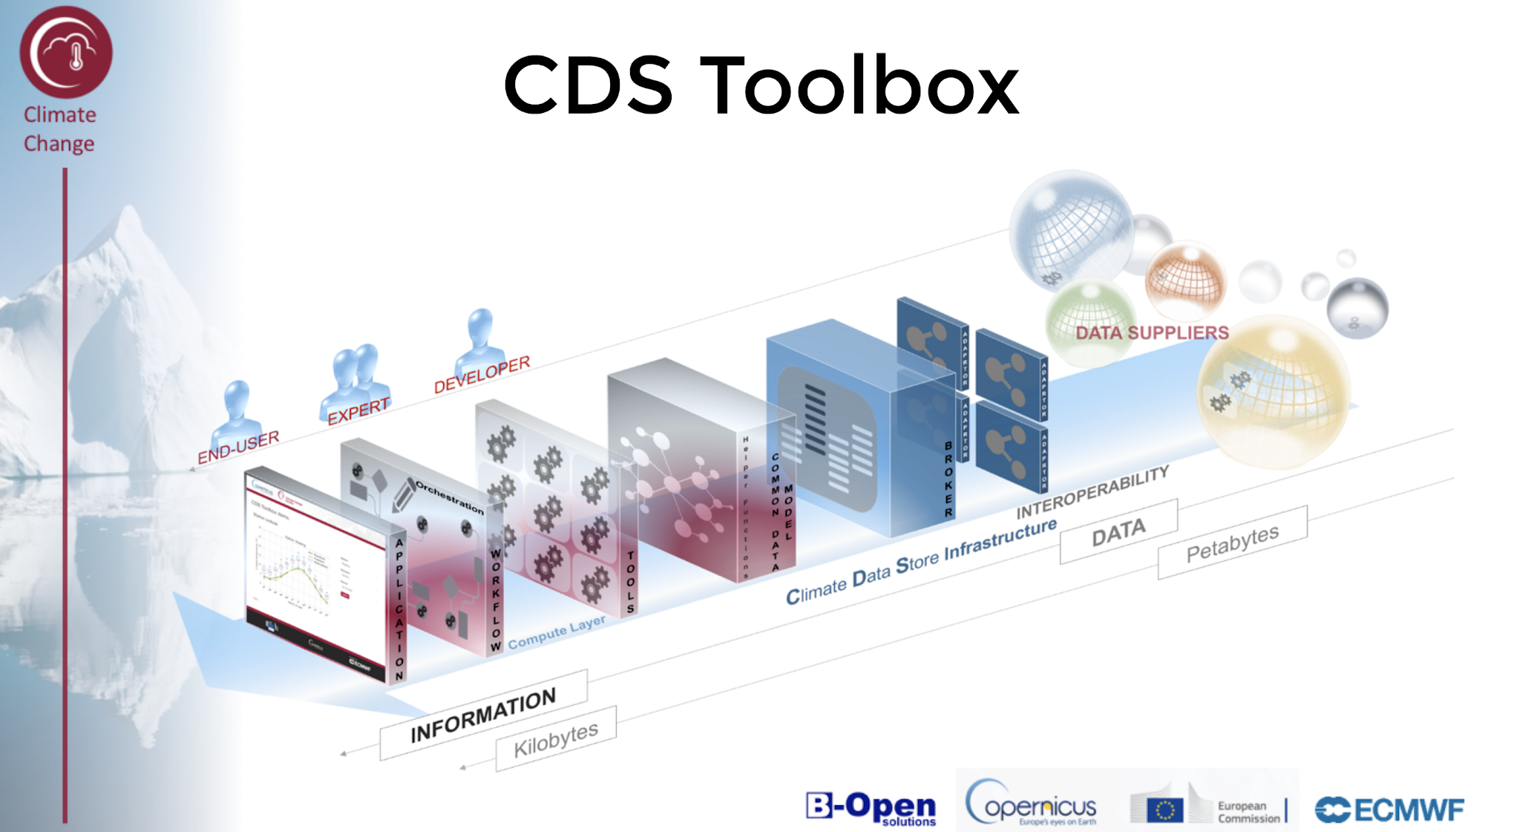
Project: Copernicus Climate
CP4CDS
ESGF Data-Node
(CMIP5 Model Data)
WPS
(Birdhouse Setup)
CDS: Climate Data Store
C3S: Copernicus Climate Change Service
CP4CDS: Climate Projections for Climate Data Store
<number>
Notes:
CP4CDS is data supplier for model data (CMIP5, etc) and remote processing on this data pool (WPS).
Birdhouse: provides setup and deployment for remote processing (WPS).
Describe architecture of CP4CDS
Identify Birdhouse role
Describe CP4CDS nodes
Introduce ESGF data nodes

Slide 13
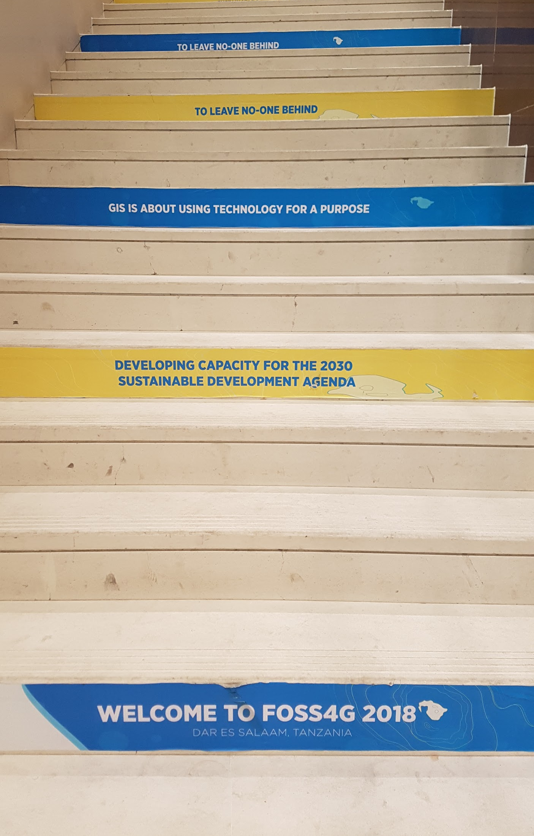
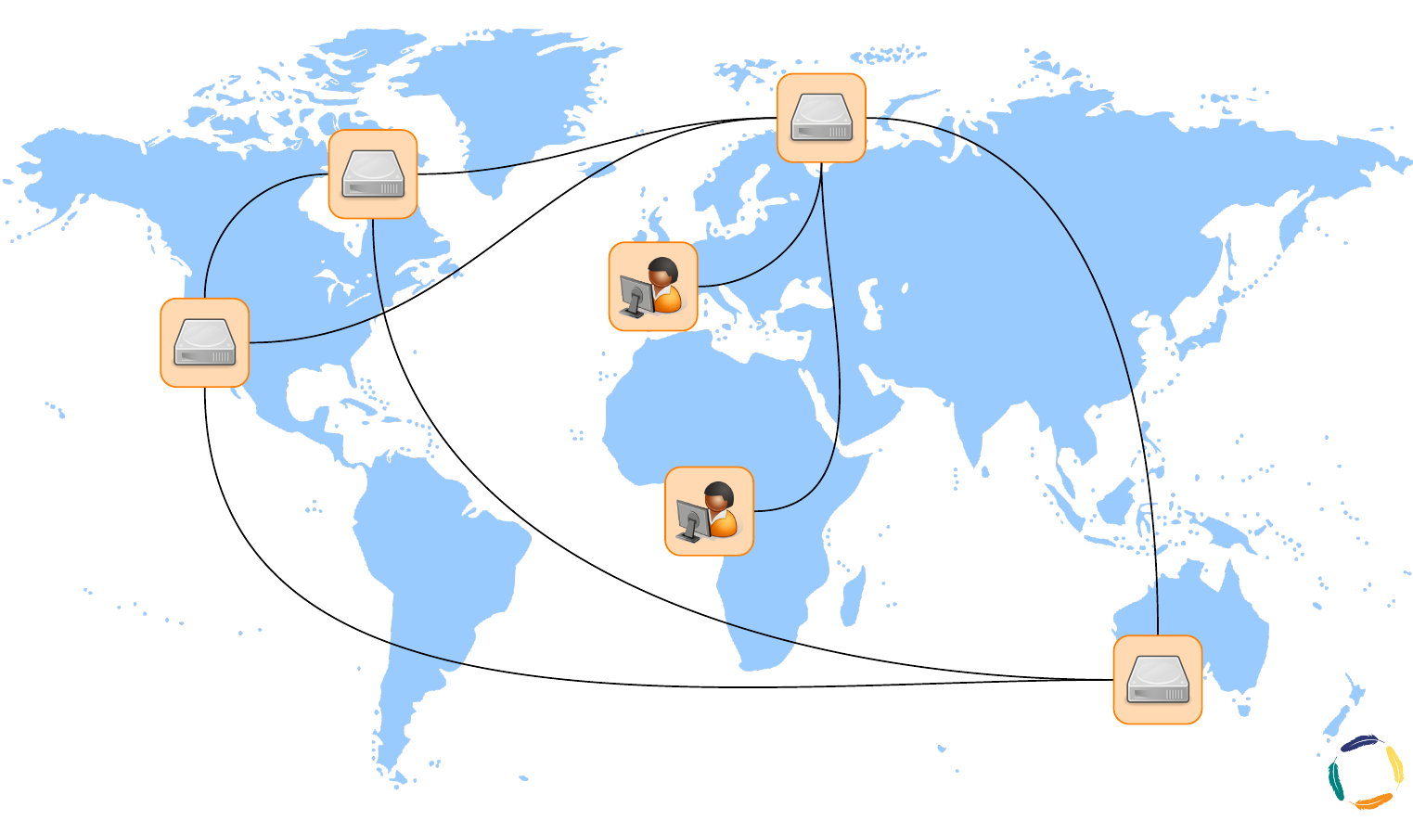
Harnessing WPS for Sustainable Development
Indicators for the
Sustainable development Goals (SDGs)
Monitoring and Reporting required from UNFCCC, UNCCD and CBD
non binding Sendai Framework for Disaster Risk Reduction - UNISDR
etc ...
Leave no one behind
<number>

Slide 14
Outlook
EU COPERNICUS
C3S with CP4CDS ready for production use in 2019.
(based on CMIP5 data)
extended for CORDEX (regional model data) in 2019/2020
extended for CMIP6 … ?
Canada
Govt of Canada: Canadian Center for Climate Services (CCCS)
Pan-Canadian federated cyberinfrastructure
Earth Observation support, integration of ML/DL
WPS on ESGF Nodes
A2C2 Service for Extreme Weather Assessment
…. etc.
http://bird-house.github.io/
<number>

Slide 15
Deleted slides
<number>

Slide 16
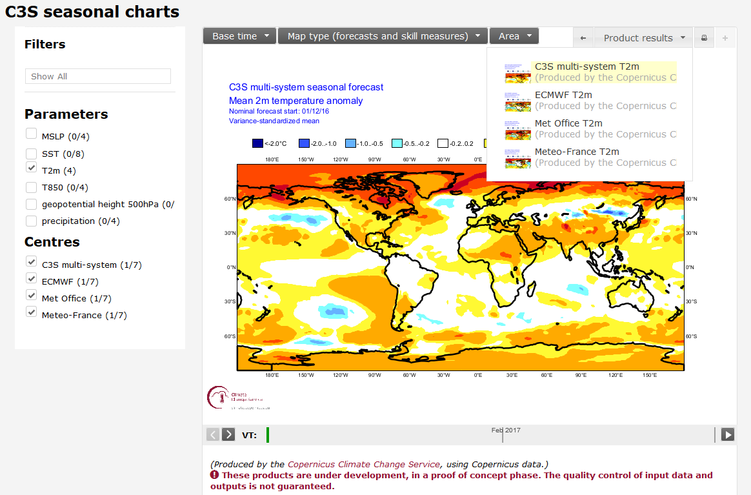
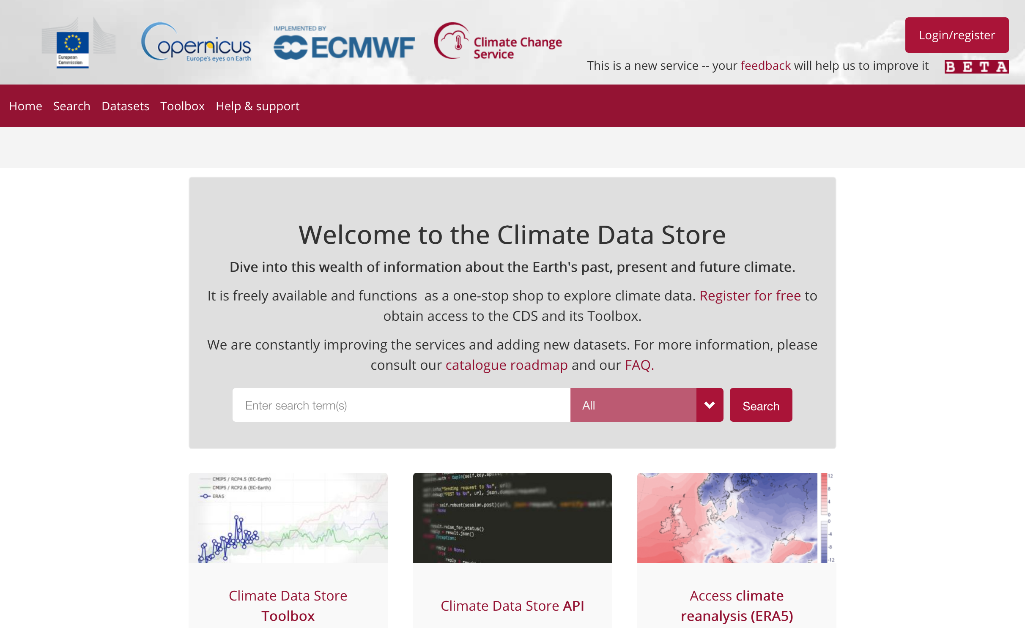
Projects: C3S and CP4CDS
C3S Portal
Data
Service
Climate Data Store
CP4CDS
Compute
Node
Data
Node
Web
Processing
Service
ESGF
Processing
Backend
Climate Model
Projections
Replication &
Quality Control
<number>

Slide 17
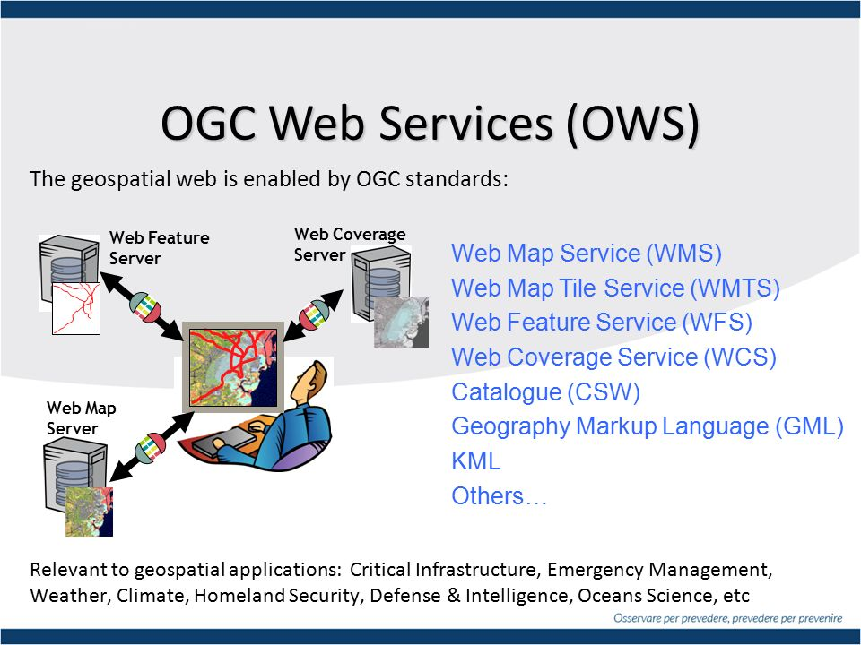

Open Geospatial Consortium
<number>

Slide 18
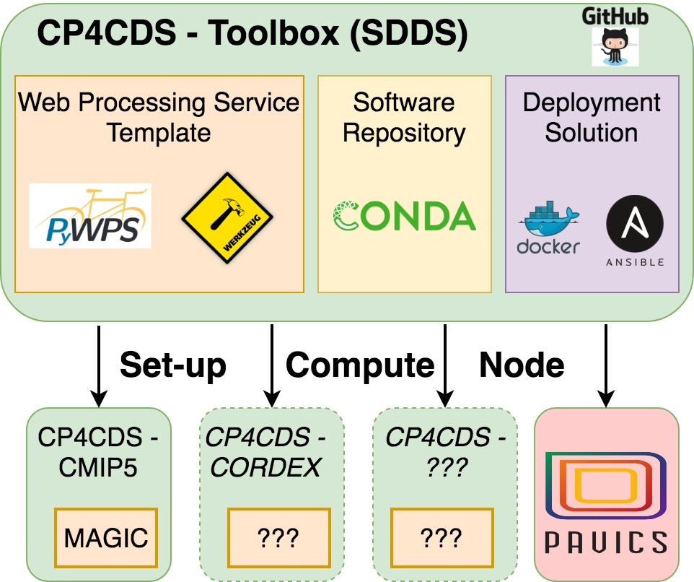
Server Side: Deployment
Deployment
Ansible & Conda
<number>
Notes:
“Simply make a new Bird for my project and run it (on my notebook, HPC cluster or container infrastructure)”
SDDS = Software Deployment and Dependency Solution
Generate PyWPS service using a Cookiecutter WPS template
Application dependencies managed with Conda (PyWPS, CDO, OCGIS, …)
Automatic install and start: make install; make start
Dockerfile generated for WPS service for automatic build of Docker image (on DockerHub)
Ansible scripts for system deployment of PyWPS service with Nginx, Postgres, …
Used by Projects: CP4CDS (Climate Projections for Climate Data Store, Copernicus EU) and PAVICS (CRIM, Ouranos, Canada)

Slide 19
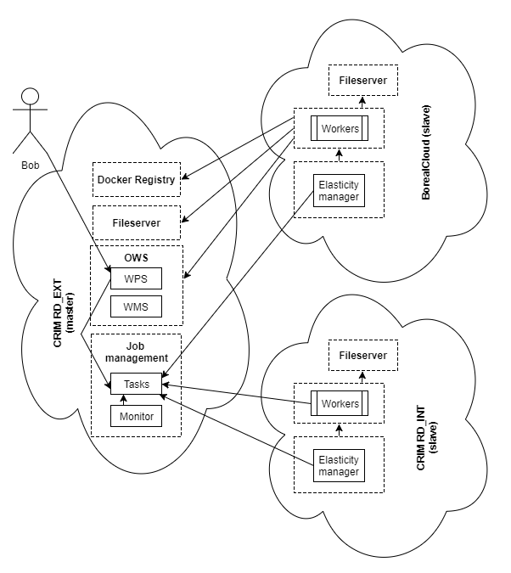
<number>

Slide 20
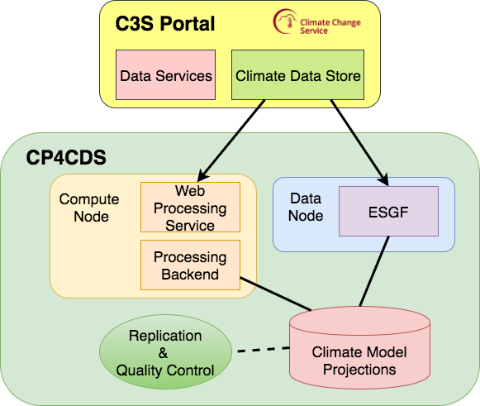
<number>

Slide 21
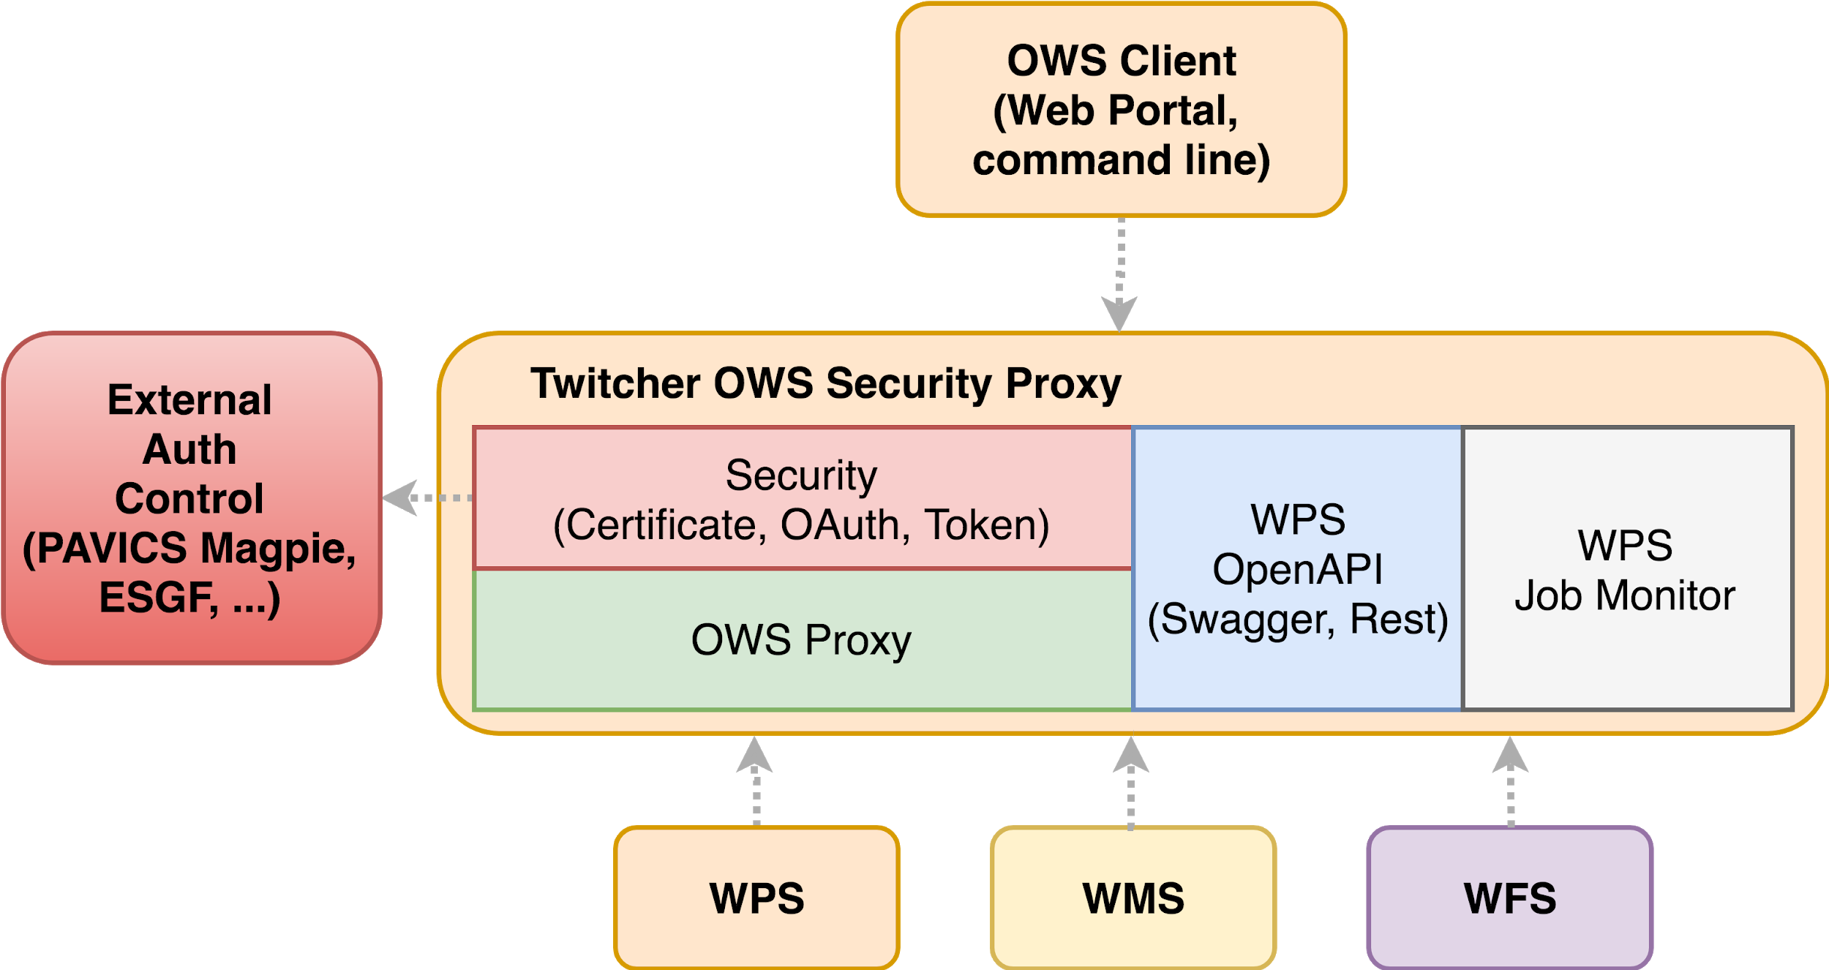
Security: Twitcher OWS Proxy
<number>
Notes:
Twitcher: security proxy for WPS and other OWS services (WMS, WFS, WCS, …)
Proxy: WPS is registered at Twitcher. Client can access service via proxy localhost/ows/wps/flyingpigeon
Security: Checks if WPS (or WMS) access is allowed. Depending on used external Auth Control this can be fine granular (on WPS process or WMS layer level ).
WPS OpenAPI: WPS protocol can also be accessed with upcoming WPS Rest API (OpenAPI, Swagger).
WPS Monitor: Processing Jobs are monitore by Twitcher. Clients don’t need to implement this.
CP4CDS: data and compute node are access restricted (certificate or token). Twitcher is security middleware in front of WPS service.
Describe Twitcher
Proxy
New prototype OpenAPI
Describe Magpie
Access control list
Token management

Slide 22

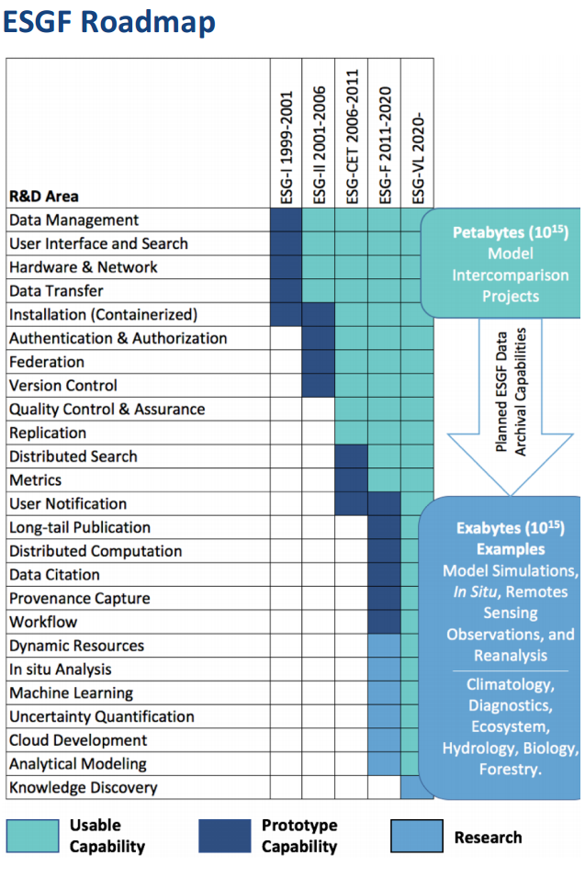
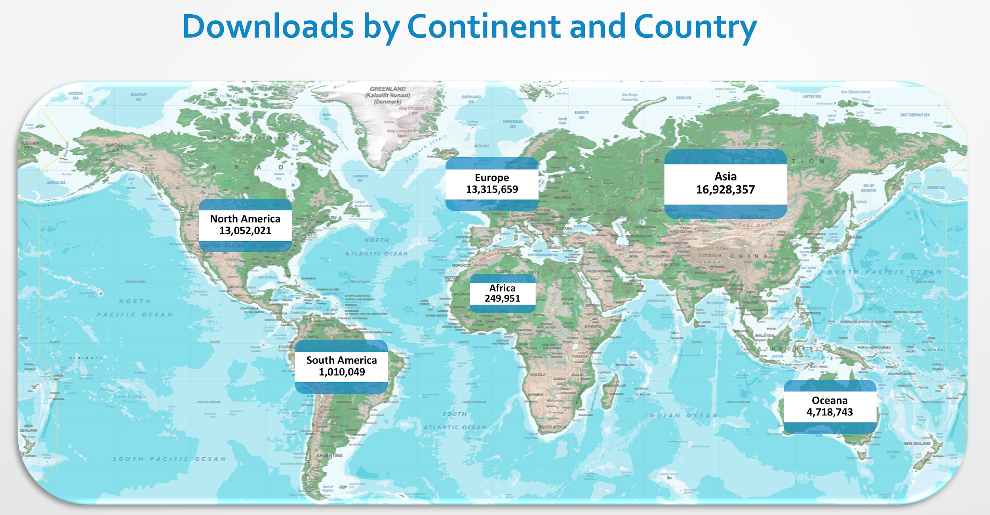
Earth System Grid Federation (ESGF)
https://esgf.llnl.gov
<number>

Slide 23
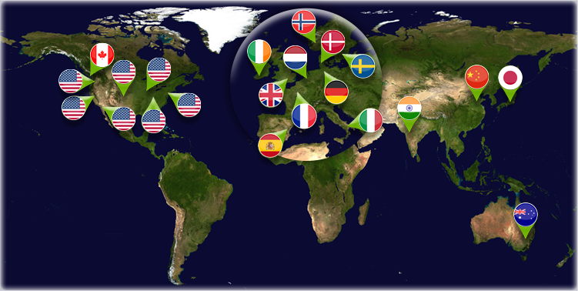
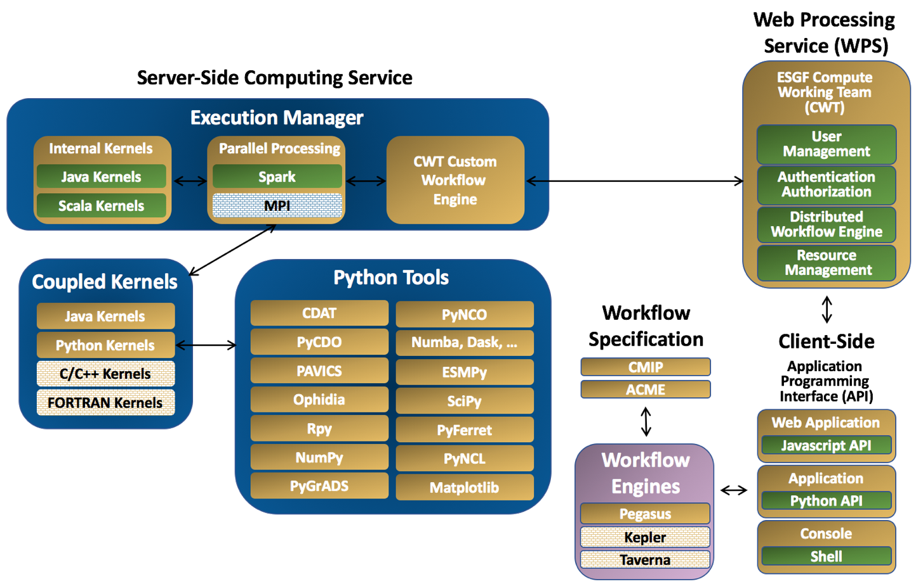
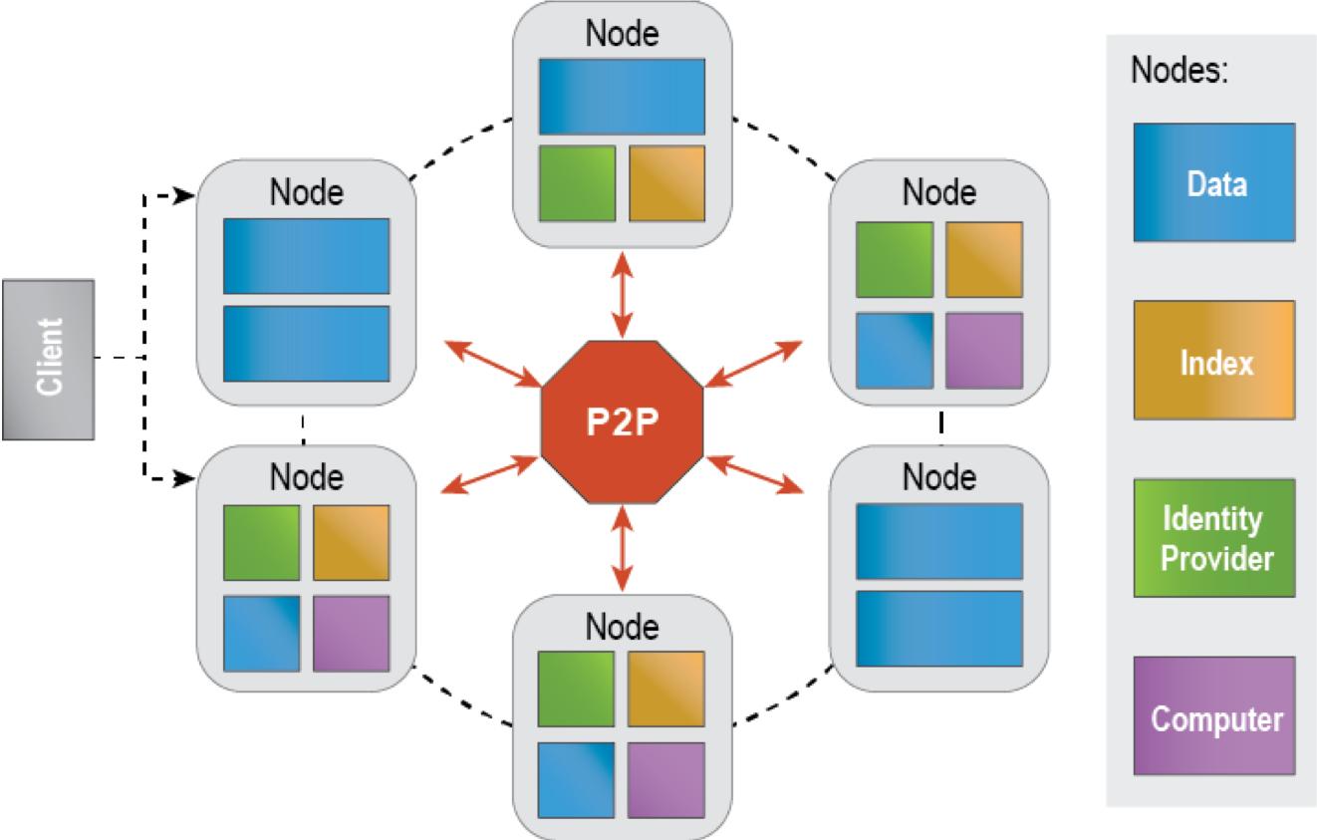
Project: Connectivity to ESGF
https://esgf.llnl.gov
<number>
Notes:
ESGF = Earth System Grid Federation
Federated Access to Climate Data (CMIP5, CORDEX, CMIP6 and more)
Main Nodes: LLNL (USA), CEDA (UK), DKRZ (Germany), IPSL (France). Several small nodes at model centers.
Data: Thredds Data Server, Index: Solr Search, Identity: x509 Certificate, Compute: WPS service interface.
Compute: WPS with ESGF process profile (Certified). ESGF Nodes are free to choose WPS service software and implementation codes.
Present compute nodes implementations
Birdhouse in ESGF CWT API, get ESGF certification?

Slide 24
Open Geospatial Consortium
<number>

Slide 25
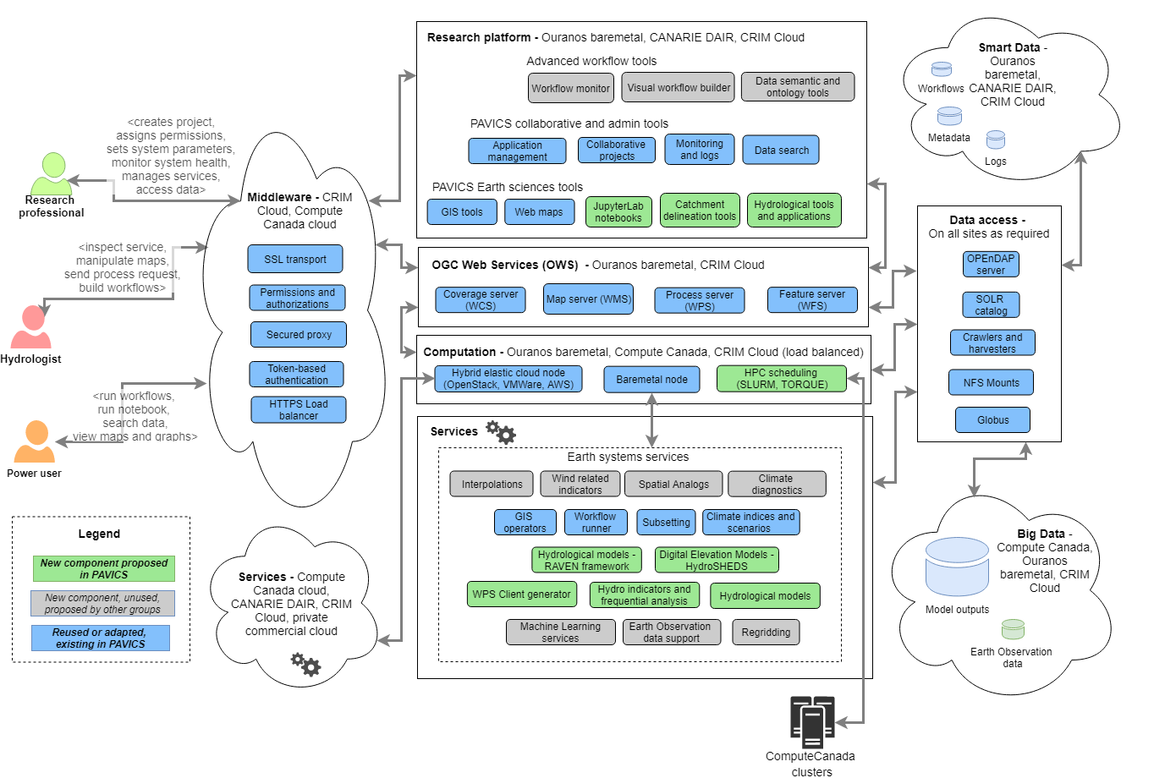
<number>

